Slide 1
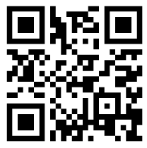
BYOD at ARES
Welcome to our parent information session!
Please register your child’s device at: www.arebyod.weebly.com

Slide 2
Vision of byod at ARES:
The BYOD will allow students to be fully engaged in challenging, authentic learning experiences to ensure all learners are collaborative, creative, effective communicators, and critical thinkers in a global community.

Slide 3
What Are The Main Reasons For BYOD?
Student participation increases
Collaboration and communication increase
Provides personalized instruction
Learning becomes student-driven
Allows more devices per classroom
Student is familiar with and can customize his/her own device

Slide 4
What Does BYOD Look Like?

Slide 5
Traffic Light System
Devices in Bookbag
Turned off
On silent/vibrate
Devices are out, on
desks, and able to
be used for learning
Notes:
Kindles are not ideal because it’s hard to access networks, but they may be brought for read to self time and another device can be used for other classroom applications.

Slide 6
What Devices can my child bring?
Your child may bring internet-enabled devices that can connect to the district’s wireless network.. Devices may include, but are not limited to:
iPod Touches
iPads
tablet computing devices
smartphones
laptops
netbooks
Notes:
Kindles are not ideal because it’s hard to access networks, but they may be brought for read to self time and another device can be used for other classroom applications.

Slide 7
What About Controlling Where My Child Goes? What Kind Of Sites Will They Be Using?
There is a network dedicated just for the BYOD program.
To add it to your child’s device: WAKE-BYOD
We have the same filters on our BYOD network as on our regular network.
Parents should set restrictions on the device. If you do not know how to do that, please ask for help!
Students will be expected to follow the school’s BYOD contract.

Slide 8
Security- Damage/Theft
Alston Ridge Elementary is NOT responsible for your child’s device.
Teachers will make every effort to encourage responsible handling of personal devices.
Devices should be in some kind of protective case - especially when transported to and from school.
Devices will not be handled by ANYONE other than your child. Staff and other students are to follow the “Hands Off” policy at all times.
Devices are to remain in the student’s backpack or carrying bag when not in the classroom and taken home every day.
Once in the classroom, devices will be kept in a designated area in the classroom or backpack depending on the class activities that day.
Classrooms will be locked when the class leaves for specials, lunch, recess or any other full class activity.
Parents should discuss the importance of personal responsibility with their child.
Find my iPad should be turned on. (Apple devices only).

Slide 9
What If My Child Can’t Bring In A Device?
Students who cannot bring outside technology will be able to access and utilize the school’s equipment.
NO student will be left out of classroom instruction.

Slide 10
Who Is Involved In BYOD This Year?
This year, the fifth grade team will be the grade level that implements BYOD into the classroom.
Be on the lookout for further information about next year and other grade levels and teachers who are implementing BYOD.

Slide 11
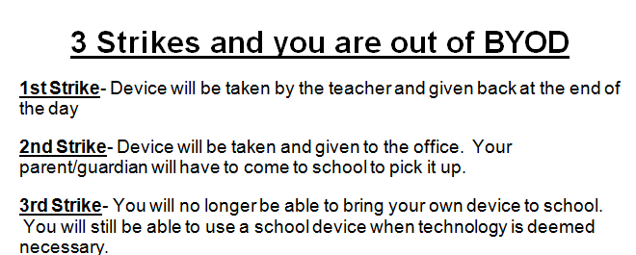

Slide 12
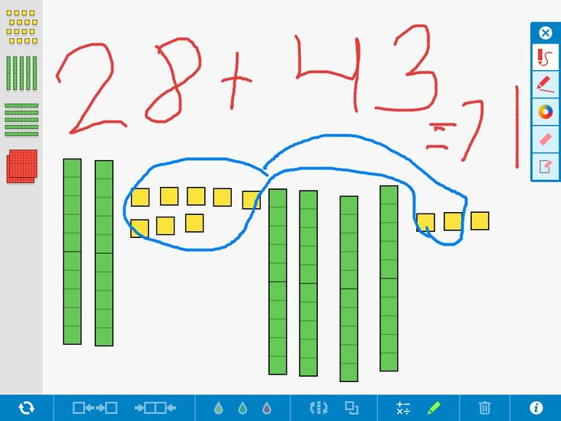
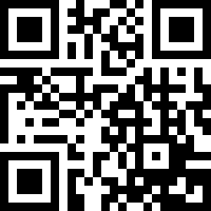
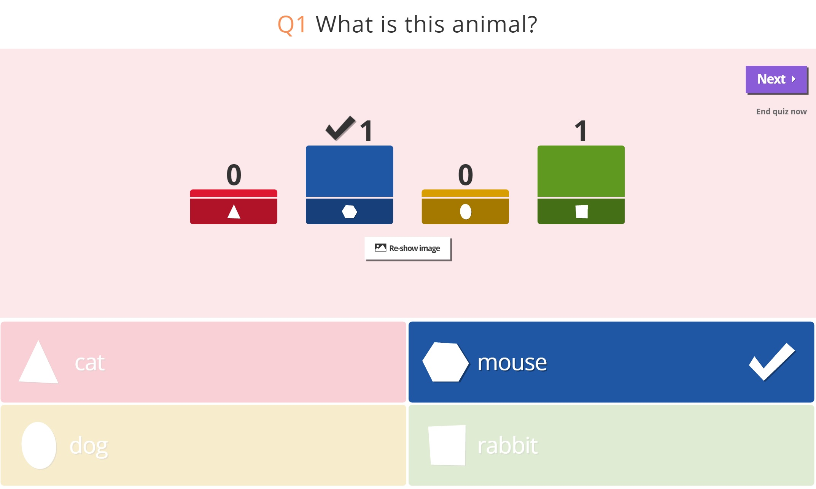
How Are Devices Currently Being Used?
Google Drive: stores documents, ability to collaborate on Google Docs, digital portfolio
DC Coached Project
Google Classroom
Access assignments provided by teacher
Ability to post comments
Seesaw: digital portfolio
QR Codes: allows students to self-check their answers or lead students through an activity
Kahoot or Plickers: used to gauge student’s understanding of the topic being taught in real time - immediate feedback to students and teachers

Slide 13
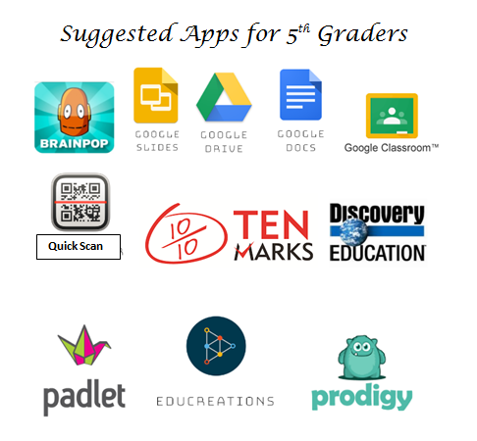

Slide 15
BYOD Guidelines
Students AND guardians are required to sign the BYOD contract.
ONLY the owner of the device can touch the device…not a friend or even a teacher.
Device is for instructional purposes only.
ARE is not responsible for providing facilities to charge devices. Devices are expected to be charged at home and put away after the battery loses its charge.
Students will not be allowed to use devices at recess.
School Staff reserves the right to change procedures and storage of devices as needed. “The Three Strike System”

Slide 16
When Will Devices Be Used?
Who Decides When Students Use BYOD? BYOD will be used for instructional purposes only. Teachers will communicate to students when BYOD is appropriate.
Can Students Share Devices? Students understand they are prohibited from using any student’s device other than their own. It is clearly written in the contract that students are responsible for their own device(s).
How Do Students Sign Up for BYOD? Students and parents will sign the BYOD contract and return to their homeroom teacher. Once they are signed onto the network and the proper apps are downloaded, they are ready to use their devices.

Slide 18
Stations:
You can now visit the following stations:
Wake County Representative Chris Wasko, Ph.D. - WCPSS ITLMS Personnel, BYOD Coordinator- Media Center
Access to BYOD Network, Adding Apps/Signing into Google– Cafeteria
Please Return Signed Contracts and Register your device before leaving. Thank you for coming!

Slide 19
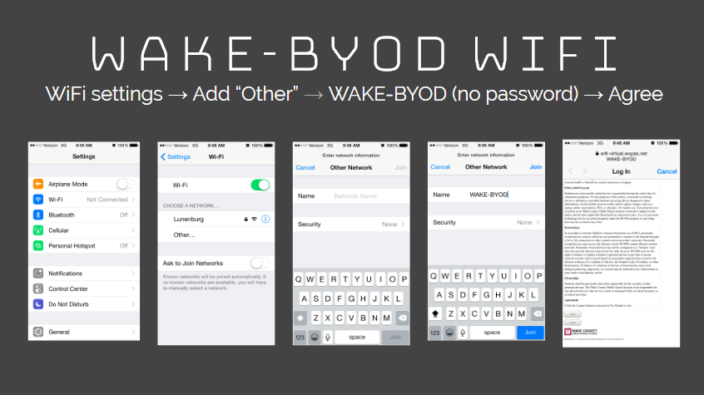

Slide 21
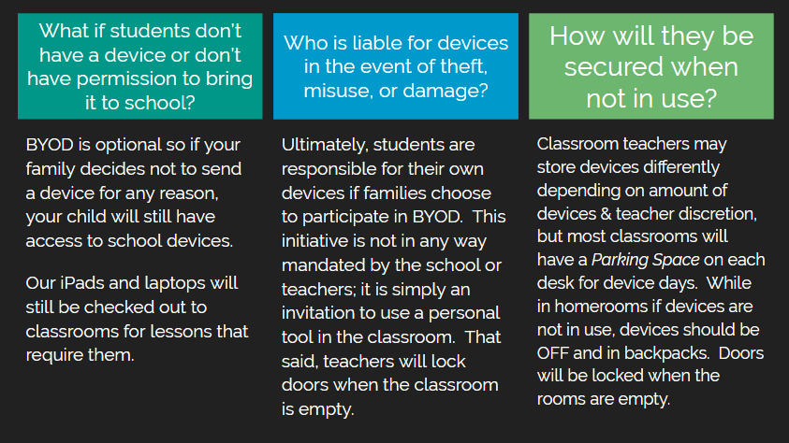

Slide 22
